Slide 1





Lemon
Movie Booking
system
By
(Eating-lemon |
Kevin 杨一帆（Yang yifan）,
Fay 李卓（li zhuo），
Duke 帅志鹏（shuai zhipeng）,
Luctio黄淇厚（huang qihou)
Roll No.B4 | Date 05.23
Notes:
更多精美PPT模板下载：
http://so.tukuppt.com/sousuo/15770370/

Slide 2







List
06
01
Background
05
Summary
03
Concrete display
Requirement
02
END
04
Introduction
Modules

Slide 3

01
Background

Slide 4

Background
Since entering the twenty-first world, the development of science and technology in the world has been very rapid, and there has been a rapid development in the film industry.
The number and types of movies have been constantly increasing, the grade has increased, the number of people has increased, and the mode of diversification.
These changes directly lead to the difficulty of the management of the film and television city gradually increased, and the design and production of a suite of modern film industry has been made.
The film city management system of the industry has become a very practical and valuable work needed by the reality.

Slide 5

02
Introduction

Slide 6





Lemon

Slide 7

Introduction
This system is a project thesis based on the function of the whole movie ticket booking system and its realization. This movie ticket selling system realizes the functions of e-commerce from the first step of commodity management to the second step of commodity classification and inquiry, to the function of shopping cart in the whole process, the processing of user orders in the background, and the whole system administrator.
It can give full play to information exchange and commodity trading between users and businesses on the Internet. Throughout the whole movie ticket booking system, because of the convenient operation and universality of the network, it can make the whole system simple and convenient. It is also very simple to operate. It is easy to use by both businesses and users. At the same time, it also facilitates the communication between businesses and users.

Slide 8

03
Requierment

Slide 9

Registration and login
user
View movies
could
Choose movie
And seat
Buy tickes
此处输入文字描述：mm1102专业PPT设计师，下载更多精品高质量PPT模板，请搜索：mm1102。此处输入文字描述：mm1102专业PPT设计师，下载更多精品高质量PPT模板，请搜索：mm1102。此处输入文字描述：mm1102专业PPT设计师，下载更多精品高质量PPT模板，请搜索：mm1102。

Slide 10
login
Adminis-trator
Operate on movies
could
Operate on users
Background monitoring
此处输入文字描述：mm1102专业PPT设计师，下载更多精品高质量PPT模板，请搜索：mm1102。此处输入文字描述：mm1102专业PPT设计师，下载更多精品高质量PPT模板，请搜索：mm1102。此处输入文字描述：mm1102专业PPT设计师，下载更多精品高质量PPT模板，请搜索：mm1102。

Slide 11
04
Modules of software

Slide 12

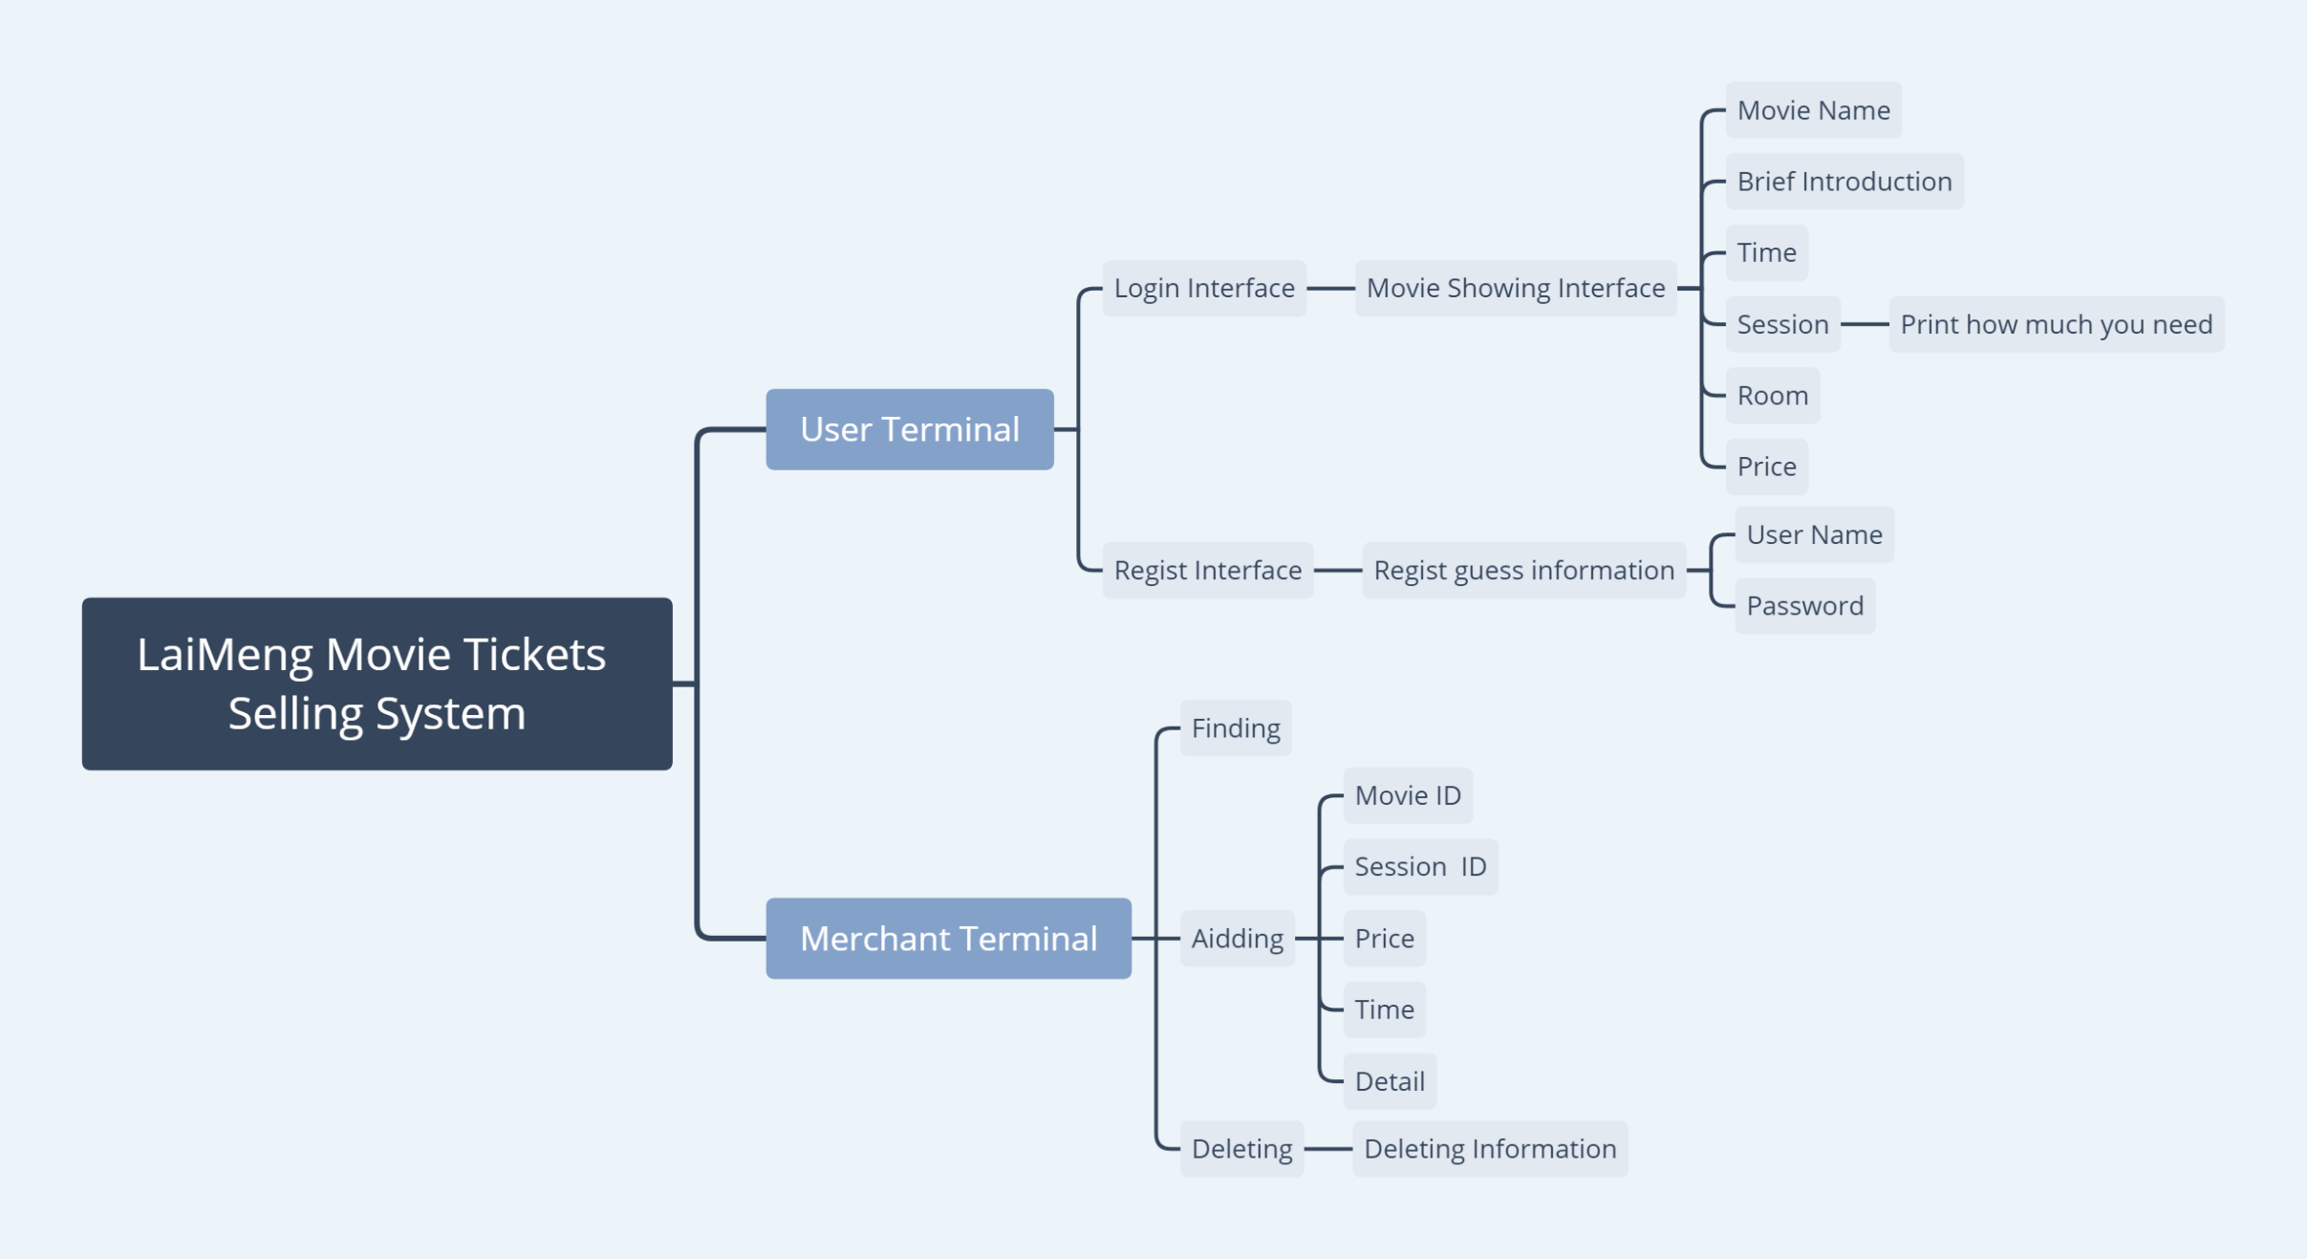
1
请在此处输入详细的文字介绍信息和简介，表达图表的含义.表达图表的含义.
2
请在此处输入详细的文字介绍信息和简介，表达图表的含义.表达图表的含义.
3
请在此处输入详细的文字介绍信息和简介，表达图表的含义.表达图表的含义.
4
请在此处输入详细的文字介绍信息和简介，表达图表的含义.表达图表的含义.
5
请在此处输入详细的文字介绍信息和简介，表达图表的含义.表达图表的含义.
6
请在此处输入详细的文字介绍信息和简介，表达图表的含义.表达图表的含义.

Slide 13
05
Part of
Concrete display

Slide 14

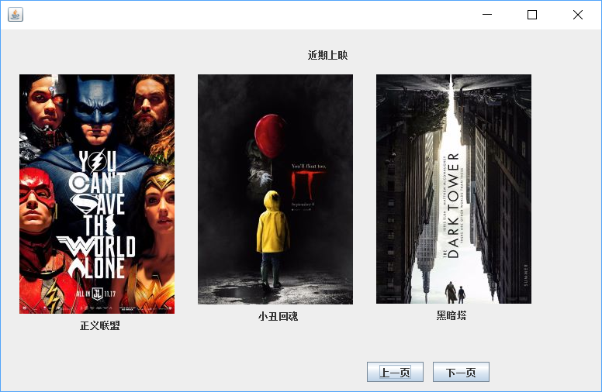
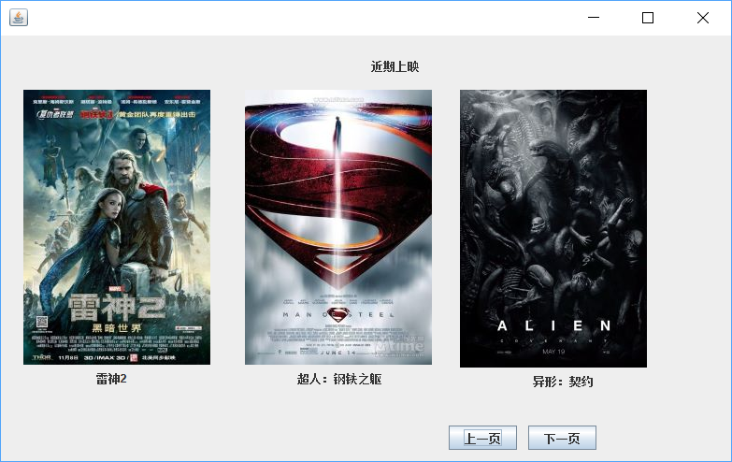
User browsing interface

Slide 15
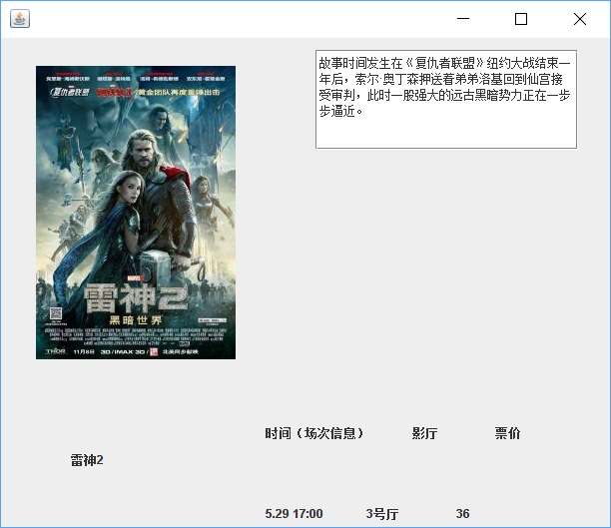
Click on the poster to view details

Slide 16
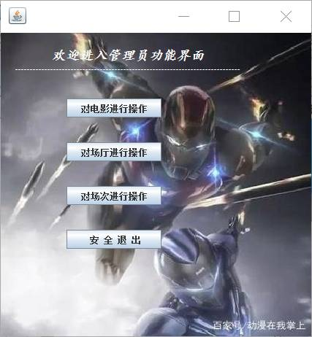
Administrator page

Slide 17
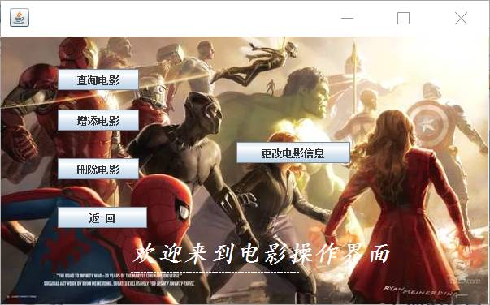
Movie operation

Slide 18
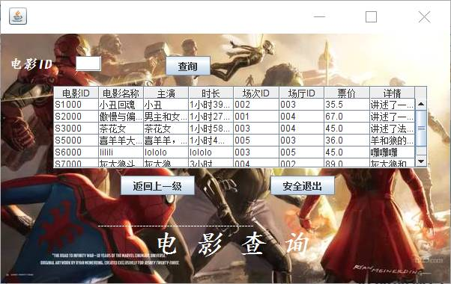
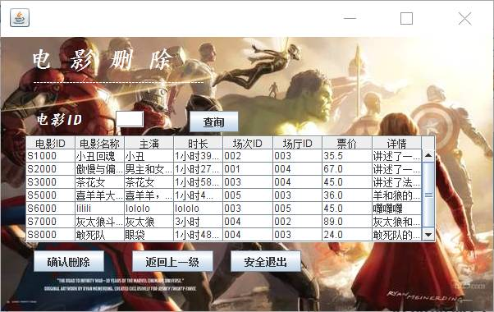
Demand
Delete

Slide 19
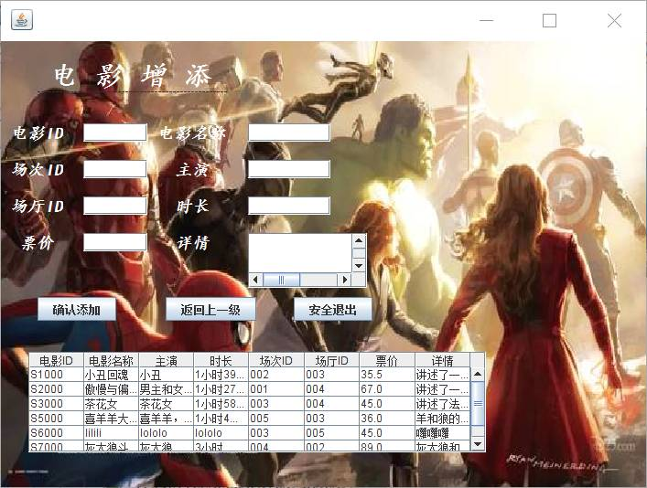
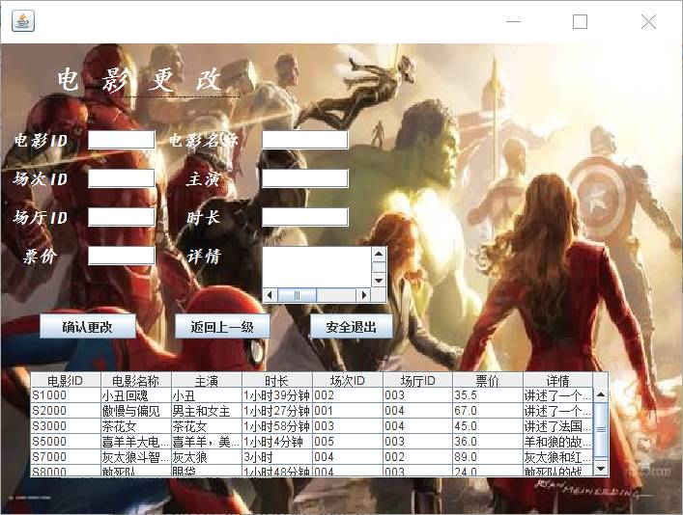
Add
Alter

Slide 20
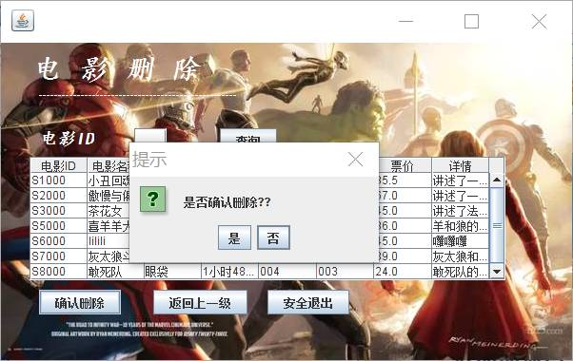

Delete confirmation
Delete
revocation

Slide 21
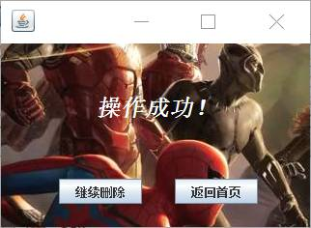
Successful opration

Slide 22
Administrator page

Slide 23
06
Summary

Slide 24

Summary
This system has beautiful and friendly interface, easy operation, and has made its own characteristics.
Due to the time rush and lack of system development experience, the system inevitably encounters a variety of problems in the design process. Through the continuous optimization and improvement of the system, we can debug the theater ticketing system which is really in line with the actual situation, and integrate all the relevant theater management information systems to form a unified, standardized, scientific and reasonable theater ticketing system, so as to improve the management level.

Slide 25
Thanks For Watching
Notes:
更多精美PPT模板下载：
http://so.tukuppt.com/sousuo/15770370/

